Slide 1
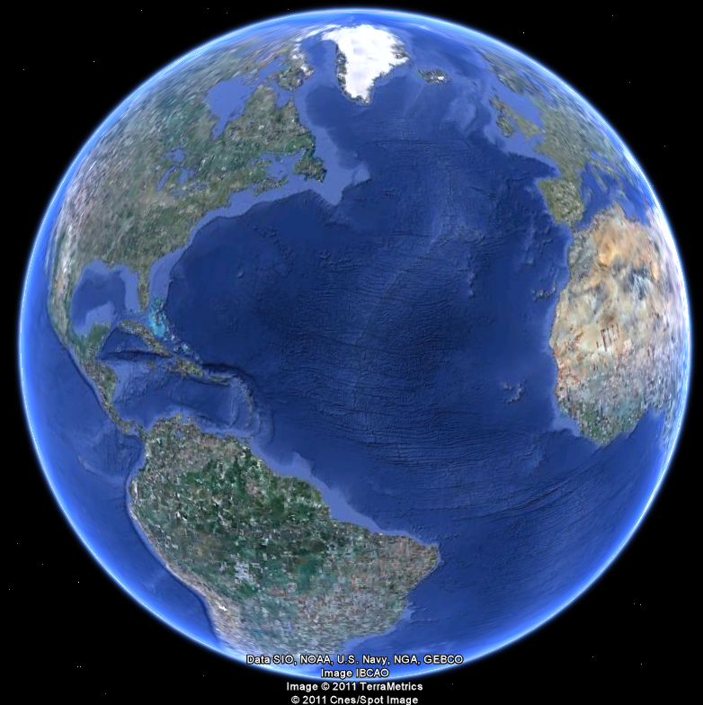
APEC 100 Sustainable Development
Economics of Common Pool Resources

Slide 2
 | RIVAL | NON-RIVAL
EXCLUDABLE | Private Goods Strawberries Blue Jeans | Club Goods Exercise Gym Pay-per-view TV
NON-EXCLUDABLE | Common Pool Resources Fish in the ocean Roads in rush hour Pollution in a lake | Public Goods Lab Experiment Clean Air Street Signs

Slide 3
Negative Externalities
External costs occur when a decision maker chooses a level of production or consumption and does not fully bear the costs of his or her actions
Party A makes a decision, which harms Party B, with no compensation and Party B had no say
Inefficient allocation
Frequently happens in natural resource setting—less so in other situations
3

Slide 4
Negative Externalities: What to Do?
Compensate those harmed directly
Property rights assumption (Coase Theorem)
Lawsuits
Pollution Standards (Command-and-Control)
Tax Pollution
Examples (Solid waste pay-per-throw policy, turtle harvest tax, water pollution taxes, development impact fees)
Challenge - finding appropriate tax rates

Slide 5
Negative Externalities: Marketable Permits
Examples of Marketable Permits
Telluride wood fireplace program
Cap-and-Trade SO2 program (acid rain)
Cap-and-Trade Greenhouse Gas programs
Opportunities and Challenges of Marketable Permits
Lower costs for industry and administration
Environmentalists can buy quality
Pollution hot spots

Slide 6
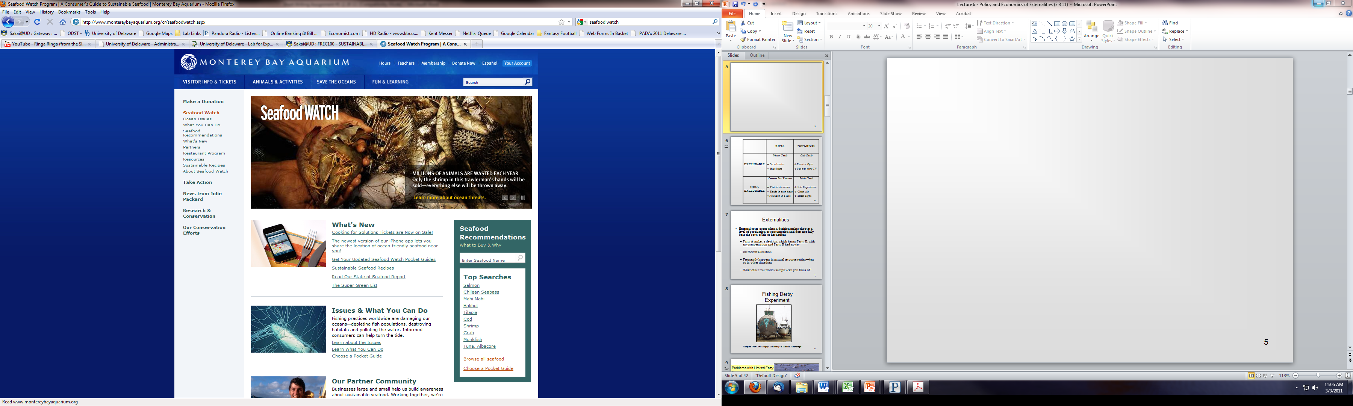
Negative Externalities: Consumer Action
Consumer Action
Careful buying
Labeling of ‘green products’
www.montereybayaquarium.org/cr/seafoodwatch.aspx

